Slide 1
Mines, Minerals, and Minecraft
Dr. Charles “Chuck” Bell
Lesson 6: 6 March 2019

Slide 2
Agenda
Bible Study: 10-15 minutes
The Raspberry Pi: 5-10 minutes
Hacking Minecraft with Python: 30-45 minutes
Lab Time: Building Houses

Slide 3
Bible Study
Seven Coins Named in the New Testament

Slide 4
Introduction
There are seven coins named in the New Testament from 7 different Greek words.
There are also many coins named in the Old Testament which we will document in time, the most famous being the gold "daric" produced by Darius the Mede (Daniel 5:30-31).
Mina and talent are money terms used in the New Testament but they refer to weights of silver rather than coins.

Slide 5
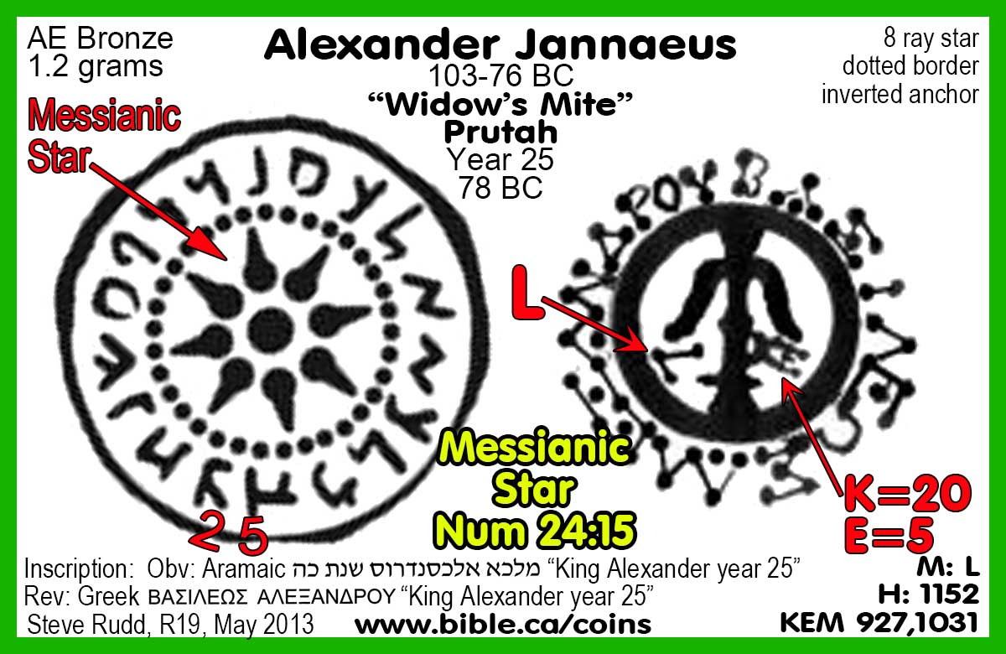
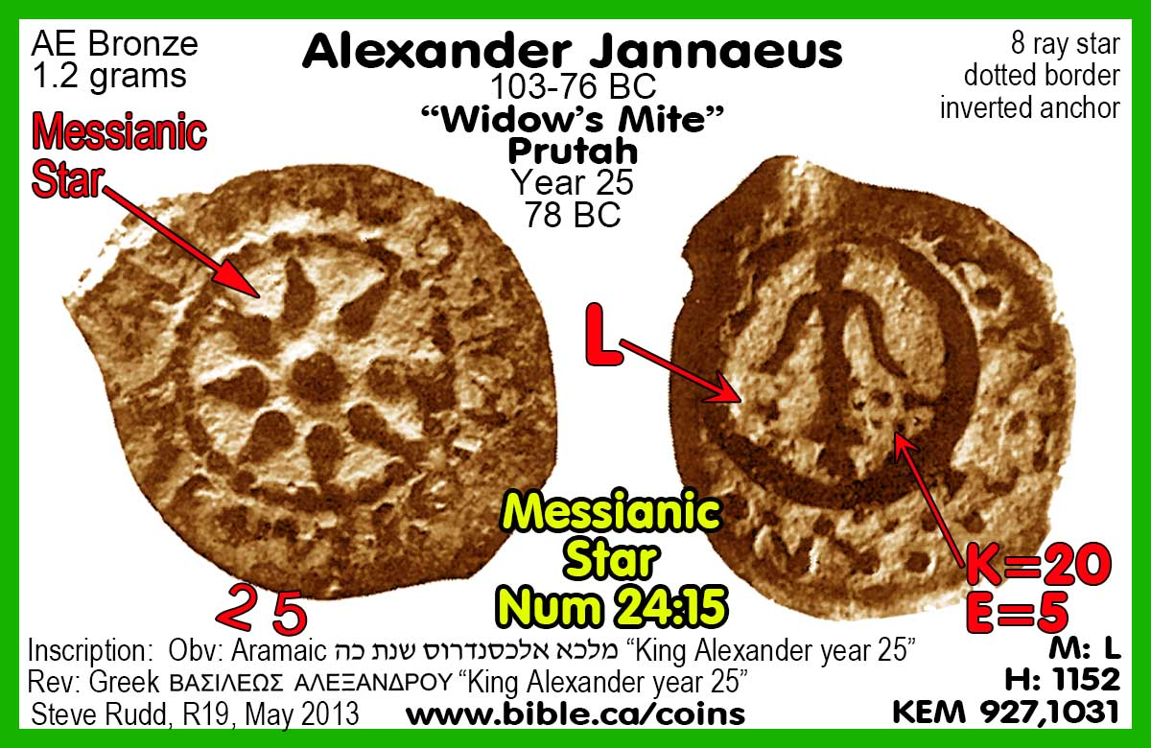
1. Widows Mite
Lepton: ”widows mite" (Mark 12:42, Luke 12:59; 21:2)

Slide 6
2. Drachma
The drachma is an unusual coin of Christ’s time.
The Roman denarius has long replaced the Seleucid/Greek silver coins and was their equivalent.
It has been thought that perhaps the coin (mentioned only in Luke 15:8) was a Cappadocian drachma, bearing Tiberius’ bust, since these coins have been found in Palestine and were contemporary with Jesus’ story of the woman and her lost coin.
Jesus’ reference seems to be to a bride’s dowry portion retained from a wedding.
Such coins would be passed from mother to .

Slide 7
3. Didrachma
The didrachma and tetradrachma (actually stater) are references to silver coins from the city of Tyre, used in the business of the Temple. (Matthew 17:24)
The staters were equal to shekels, and because the Jews were forbidden to issue their own silver coins, they were forced to use coins from this merchant city.
Ironically, the coins bore the image of Israel’s old nemesis, Baal.
Money-changers were on hand to render service, changing foreign currency into these Tyrian coins for a percentage.
Judas was paid with thirty staters.

Slide 8
4. Tyre Shekel
Stater Or Tetradrachma - silver coin minted in Jerusalem.
It was Herod's only silver.
When Herod completed the temple in 18 BC, he needed direct control over the most important coin of his new temple: the official Temple Tax shekel.
So Herod the Great transferred the production from Tyre to Jerusalem.
This is by far the most important coin in the New Testament because it is part of four different Bible

Slide 9
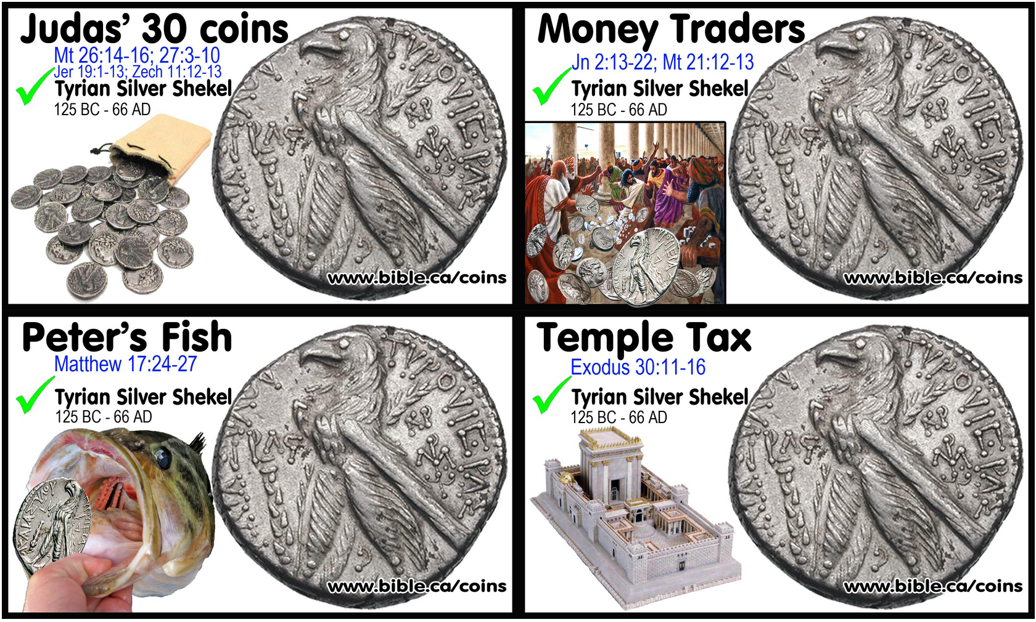
4. Tyre Shekel

Slide 10
5. Quadrans
The quadrans was an Imperial Roman coin meant to circulate throughout the Empire. (Mt 5:25; Mark 12:42)
The size of a Canadian or US cent, the quadrans bore the religious symbols.
The King James Version renders this coins as a “farthing”, which is an old English coin.

Slide 11
6. Assarius
The assarius was an Imperial Roman coin meant to circulate throughout the Empire. (Mark 10:29; Luke 12:6)
The assarius was larger than the quadran and usually pictured the emperor.
The King James Version also renders this coin as a “farthing”, which is an old English coin.

Slide 12
7. Denarius
The denarius is the most referenced coin in the New Testament: sixteen times. (Matthew 18:28, 20:2, 9-10)
The denarius was a silver coin the size of a U.S. dime and was worth ten assarii.
This is the coin rendered “pence” and “penny” in the King James Version.
Civil taxes to Rome had to be paid in this coin. Pious Jews questioned the morality of such an act.

Slide 13
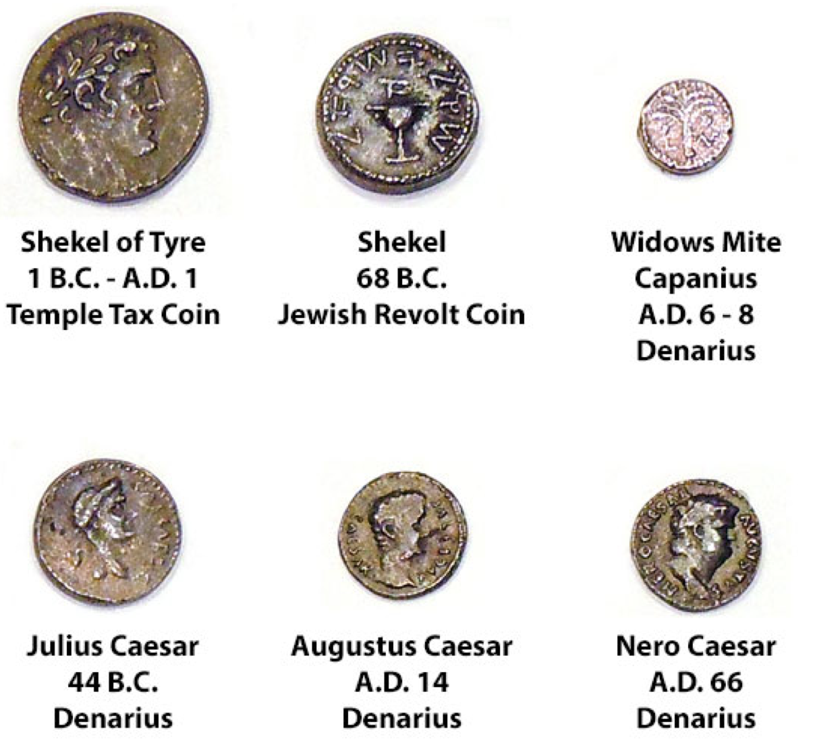
Coins of the New Testament

Slide 14
The Raspberry Pi – Python Programming

Slide 15
Python? Isn’t that a snake?
Python was developed by Guido van Rossum from the late 1980's to early 1990's in the Netherlands.
It was derived from and influenced by many programming languages including Modula-3, C, C++, and even Unix shell scripting languages.
Fourth generation scripting language.
Used by many developers for systems operations and application (devops), scripting, and more.
Is one of the “P”s in LAMP stack (Linux, Apache, MySQL, Python/Perl/PHP)
A fascinating fact about Python is it was named after the BBC show, “Monty Python's Flying Circus” and has nothing to do with the reptile by the same name.
In fact, quoting Monty Python in source code documentation (and even a humorous diversion for error messages) is very common and while some professional developers may cringe at the insinuation, it's considered by Pythonistas as showing your Python street cred.

Slide 16
who (what) is Monty python?
Monty Python were a British surreal comedy group who created Monty Python's Flying Circus, which first aired on the BBC in 1969 featuring a series of short skits (sketches). Does that sound familiar?
Members include Graham Chapman, John Cleese, Terry Gilliam, Eric Idle, Terry Jones, and Michael Palin
The show ran from 1969 to 1974
The troupe also made several movies including And Now for Something Completely Different, Holy Grail, Life of Brian, Live at the Hollywood Bowl, and Meaning of Life
Also performed on Broadway (and film) called Spamalot (named after one of their skits)
Considered by many to be “intellectual” humor

Slide 17
Hacking Minecraft with Python
Free Lab Time
Let’s build some houses!

Slide 18
Review: icehouse2.py
from mcpi.minecraft import Minecraft
from mcpi import block
mc = Minecraft.create()
p = mc.player.getTilePos()
mc.setBlocks(p.x + 1, p.y, p.z + 1,
p.x + 10, p.y + 5, p.z + 10,block.ICE)
mc.setBlocks(p.x + 2, p.y + 1, p.z + 2,
p.x + 9, p.y + 4, p.z + 9,block.AIR)
mc.setBlocks(p.x + 5, p.y + 1, p.z + 1,
p.x + 6, p.y + 3, p.z + 1,block.AIR)
mc.setBlocks(p.x + 2, p.y, p.z + 2,
p.x + 9, p.y, p.z + 9,
block.WOOL.id, 14)

Slide 19
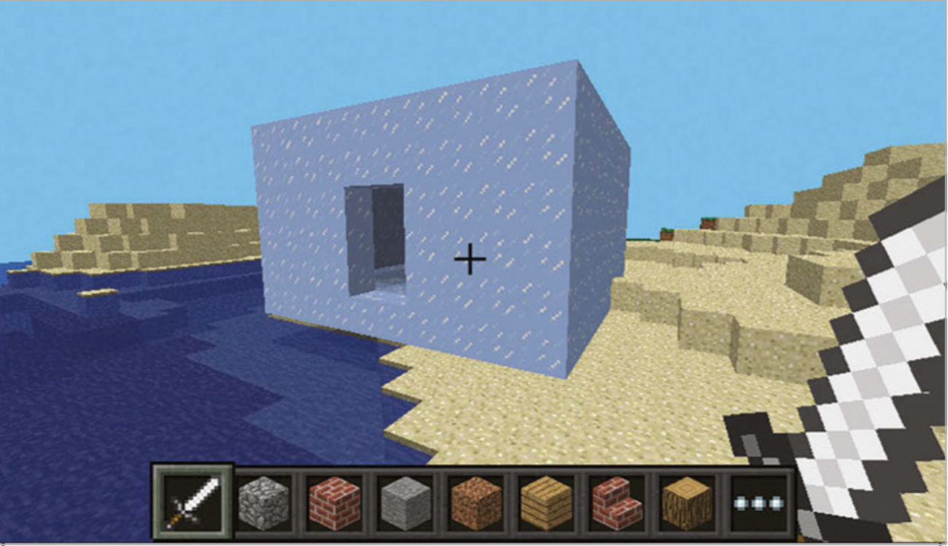
Building an Ice House

Slide 20
bighouse.py
from mcpi.minecraft import Minecraft
from mcpi import block
# Connect to Minecraft
mc = Minecraft.create()
# Determine the Player's current position.
x,y,z = mc.player.getTilePos()
width = 5
height = 3
depth = 6
# Create a hollow shell made of bricks.
mc.setBlocks(x, y, z+3, x+width, y+height, z+3+depth, block.BRICK_BLOCK.id)
mc.setBlocks(x+1, y, z+4, x+width-1, y+height-1, z+2+depth, block.AIR.id)
# Set the floor.
mc.setBlocks(x-1, y-1, z+2, x+1+width, y-1, z+4+depth, block.COBBLESTONE.id)
# Add a Door.
mc.setBlock(x+1, y, z+3, block.DOOR_WOOD.id, 0)
mc.setBlock(x+1, y+1, z+3, block.DOOR_WOOD.id, 8)

Slide 21
bighouse.py
# Add Windows.
mc.setBlocks(x+3, y+1, z+3, x+4, y+2, z+3, block.GLASS.id)
mc.setBlocks(x+2, y+1, z+3+depth, x+3, y+2, z+3+depth, block.GLASS.id)
mc.setBlocks(x, y+1, z+5, x, y+2, z+7, block.GLASS.id)
mc.setBlocks(x+width, y+1, z+5, x+width, y+2, z+7, block.GLASS.id)
# Add a Roof.
for i in range(int(width/2) + 1):
mc.setBlocks(x+i, y+height+i, z+3,
x+i, y+height+i, z+3+depth, block.STAIRS_WOOD.id, 0)
mc.setBlocks(x+width-i, y+height+i, z+3,
x+width-i, y+height+i, z+3+depth, block.STAIRS_WOOD.id, 1)
# Gable ends.
if (int(width/2) - i > 0):
mc.setBlocks(x+1+i, y+height+i, z+3,
x+width-i-1, y+height+i, z+3, block.BRICK_BLOCK.id, 0)
mc.setBlocks(x+1+i, y+height+i, z+3+depth,
x+width-i-1, y+height+i, z+3+depth,
block.BRICK_BLOCK.id, 1)

Slide 22
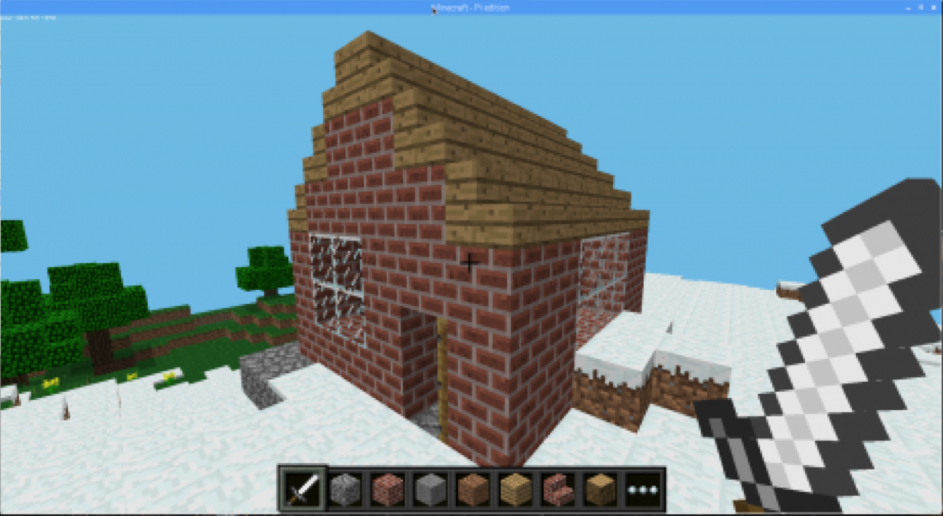

Slide 23
Fun with Blocks
Let’s build a different kind of house.
Start a new file and enter this code and run it.
Name the file surprise.py.
Run the code and try hitting the huge block with your sword. What happens?
from mcpi.minecraft import Minecraftfrom mcpi import blockmc = Minecraft.create()
pos = mc.player.getTilePos()
mc.setBlocks(pos.x+1, pos.y, pos.z+1,
pos.x+6, pos.y+5, pos.z+6, 46, 1)

Slide 24
LAB TIME
Use the remainder of class to explore the house examples. Try different values for the blocks and size of the house. Make as many houses as you want!
You can leave when you’re finished.
DO NOT DISTURB the other classes!
REMEMBER TO SHUTDOWN YOUR RASPBERRY PI
DO NOT POWER IT OFF UNTIL YOU SHUTDOWN

Slide 25
Questions or comments?

